Slide 1


Affiliate Program & Income Plan

Slide 2
Disclaimer
Benivita Inc. is a privately owned California C-Corporation that serves as the investment and private equity arm for Benivita PLSH (BPLSH). Benevita Inc. operates as a Special Purpose Acquisition Company (SPAC), with its primary function being to act as a liquidity provider and asset manager for BPLSH.
Benivita PLSH (BPLSH) is a wholly owned subsidiary of Panacea Life Sciences Holdings, Inc. (PLSH), a publicly traded company headquartered in Denver, Colorado. BPLSH is a single-member, manager-managed Limited Liability Company (LLC), also based in Denver, Colorado. Its Managing Member is Leslie Buttorff.
Benivita PLSH operates under a multi-level marketing (MLM) model, focused on the sale and marketing of telemedicine subscriptions offered through its affiliated entity, Benivita Inc. BeniVita™ is not insurance and is not a substitute for major medical coverage. Visit shop.benivita.com for full disclosures.
The company is governed by its Operating Agreement, which vests full control in the executive team of BPLSH. The executive team is led by:
CEO: Retired Honorable Judge Roy Landers
Email: judge@benivita.com

Slide 3

Introduction
America’s healthcare system is collapsing for working-class and multicultural America.
100 million Americans have no primary care doctor.
84 million are uninsured or underinsured.
100+ million live with obesity or chronic disease.
Health insurance premiums have outpaced wages
by over 300%.
BeniVita™ was created to change that.
BeniVita™ is the future of healthcare:
Affordable, Accessible, and Built for
the Real America.

Slide 4
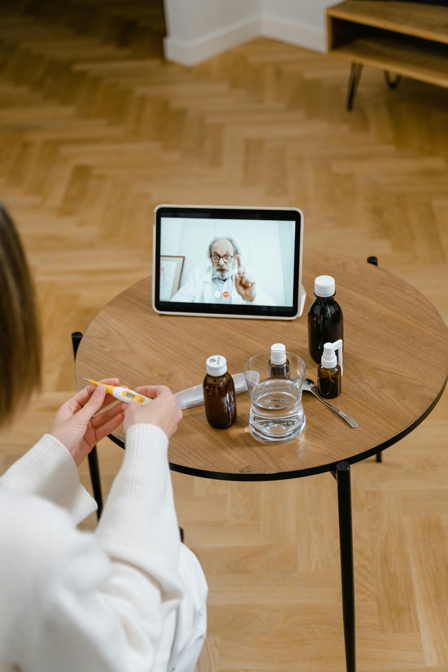
About BeniVita™
BeniVita™ is a simple monthly membership that gives you real access to the care you need—when you need it—without insurance headaches.
Whether it’s 24/7 virtual urgent care for colds, flu, ear infections, UTIs, stomach bugs, or skin issues, scheduled virtual primary care for managing chronic conditions like high blood pressure, diabetes, or cholesterol, plus preventive annual checkups, or virtual therapy sessions for mental health support—we’ve got your back.
Every plan includes hundreds of the most common generic medications for urgent and chronic care at no extra cost. Plus, your membership comes with exclusive perks: discounts on dental, vision, hearing, lab work, diagnostic imaging, diabetic supplies, and even pet prescriptions.
No co-pays. No deductibles. Just reliable, flexible care designed for your everyday life. BeniVita™ isn’t insurance—it’s a smarter way to get the healthcare benefits that actually work for you and your family.
BeniVita™ — Not insurance. Benefits for everyday life.

Slide 5

Why BeniVita™ Exists
BeniVita™ is the sister company of Epiq MD, which provides telemedicine services to businesses — serving corporations and small companies across the U.S. BeniVita™, by contrast, focuses on individuals and families, especially those in underserved or often overlooked communities.
The name BeniVita™ combines the ideas of “benefits” and “life” reflecting the company’s mission to provide benefits that support better health, well-being and a longer, more prosperous life.
This market we serve includes roughly 70 million Latinos, along with African Americans, rural Americans, and other communities that frequently face systemic barriers to healthcare access.
The platform was designed to help address common challenges such as limited healthcare access, rising medical costs, and cultural stigmas around seeking professional care and wellness services.
BeniVita™ is built on values of honesty, transparency and direct communication, which are essential to earning trust within communities that have been historically undeserved or overlooked.
The goal is to become a trusted and transparent partner, delivering simple, accessible, and user-friendly healthcare solutions that help individuals and families take control of their well-being.

Slide 6



BeniVita™ Plans
Essentials
Plus
Individual - $69.95
Monthly Recurring Subscription
Couples (2) - $79.95
Monthly Recurring Subscription
Family
Family (5) - $89.95
Monthly Recurring Subscription

Slide 7
Tier 1: Services Included with Subscription at
No Extra Cost
Recuro Health
Complete Care
Members have access to Virtual Primary Care Behavioral Health and Urgent Care from one platform. An integrated care team of board-certified primary care and behavioral health physicians. Genetic testing and health risk assessments provide for a more personalized treatment plan for acute and chronic conditions. If medically necessary, prescriptions can be sent to a member’s preferred pharmacy.
Virtual Primary Care:
Physicians are available 8 a.m. to 8 p.m. seven days a week
Ideal for managing chronic conditions like high blood pressure, diabetes, or cholesterol, plus preventive annual checkups
Urgent Care:
On-demand care with board-certified doctors for treatment of common acute medical concerns typically in less than 10 minutes
Ideal for allergies, sinus infections, ear problems, fever, nausea, pink eye, UTIs and more
Behavioral Health:
Mental health specialists are available for virtual visits typically within 48 hours for conditions such as anxiety, stress, depression, substance abuse, grief, and a wide variety of disorders

Slide 8
Tier 1: Services Included with Subscription at
No Extra Cost
ManifestRX
Did you know that over 1/3 of Americans have skipped filling a prescription because of its cost? Now, you can access hundreds of maintenance medications through home delivery and 70+ urgent care medications at local pharmacies for free. ManifestRx removes the guesswork out of medication costs by ensuring you pay the lowest price possible: $0
Fill Urgent Care Prescriptions Locally:
Accessible at over 70,000 local retail pharmacies with urgent care medication card
Home Delivery:
Enjoy 6 free mail-order shipments of regular maintenance medications per person annually. After 6 shipments, each additional shipment costs $7.99
Medication Analysis:
Get detailed analysis of specialty and brand-name medications
Nationwide Accessibility:
Available in all 50 states

Slide 9
Tier 2: Services are Discount Services Included at
No Extra Charge
Dental Powered by Aetna Dental Access
Big Savings at over 300,000* available dental locations nationwide.
• In most instances, save 15% to 50% per visit**
• Save on dental services such as cleanings, X-rays, crowns, root canals and fillings
• Need specialty dental care? Save on orthodontics and periodontics, too!
• Show your card with the Aetna Dental Access® logo and pay the discounted price at checkout
*As of February 2025. **Actual costs and savings vary by provider, service and geographical area.
Lab Testing
Know your numbers with direct access to over 1,500 major clinical laboratories nationwide to save you 10% to 80% on typical costs for lab work.
• Test categories include allergies, vitamin levels, cholesterol levels, liver function, fertility, thyroid issues, and more.
• Confidential results in as little as 24 hours for most tests.
Diagnostic Imaging
Members have access to high-quality medical imaging, gastroenterology services, and lab tests at discounted pre-negotiated rates. Along with a free diabetes wellness lab test with scheduled imaging services. One can conveniently screen for colorectal cancer with an accurate at-home kit, avoiding the need for a doctor's visit.
• Discounted and transparent rates for MRI, CT scans, ultrasounds, X-rays, colonoscopy, upper endoscopy, hemorrhoid banding and GI consults.
• 10% off at-home colorectal cancer screening kit.
• 10% off common lab tests at clinical lab locations nationwide.

Slide 10
Tier 2: Services are Discount Services Included at
No Extra Charge
Coast to Coast Vision
Big Savings at over 20,000* vision providers nationwide. save 10% to 60% on glasses, contacts, laser surgery, and exams.
• 20% to 60% off prescription eyewear including most frames, lenses and specialty items such as tints, coatings and UV protection
• 10% to 30% off eye exams
• Participating chains include LensCrafters, Pearle Vision, Visionworks, JCPenney, Target and more
• Your eye doctor not in our network? The nomination process is a breeze!
• 40% to 50% off the national average cost of LASIK surgery.
Diabetic Supplies
Save 10% to 50% on diabetic testing supplies, and get a free fully-audible blood glucose meter with your first order. With the convenient online, pre-paid program, you receive discounted diabetic testing supplies shipped directly to your home.
Services include:
Free shipping on diabetic supply packages
Tracking information updates via email or text
Annual testing program or purchase-as-needed options available
No prescription required for OTC testing supplies
100% satisfaction guaranteed, or get your money back.
*This program can be canceled, without notice, at any time for any reason.
Hearing
Retail Hearing Care by Amplifon will help you find an affordable solution with the fit, comfort, and amplification you need.
• Average savings of 64% off the manufacturer suggested retail price for hearing aids.
• One year free follow-up care for cleaning and checkups with purchase.
• Free two-year supply of disposable batteries or a charging station to keep you powered.
• Three-year warranty for loss, repairs, or damage.
• 100% money-back guarantee during your 60-day risk-free trial.
• Offering leading manufacturers including Miracle Ear, Phonak, Starkey, Oticon, ReSound, Signia, Widex, and Unitron.

Slide 11
Tier 2: Services are Discount Services Included at
No Extra Charge
NB Contacts
With savings as high as 40% and prices that regularly beat the competition by 20%, you’ll get over 15 top premium brands like BioTrue, Dailies, Biofinity, and Acuvue at deep discounts*. Whether you prefer daily, monthly, or specialty lenses,
• Enjoy deeper discounts on 6-pack, 30-pack, and 90-pack options from leading brands delivered straight to your door.
*Price Matching also available subject to terms and conditions.
NB and Pet RX
Members save 10% to 85% on most prescriptions at 60,000 retail pharmacies nationwide
• Participating retail pharmacies include Walgreens, Target, CVS, and many other independent, national, and regional chains
• Even if your members have insurance, they can present both cards at the pharmacy or research online to receive the lowest price
• My Medicine Cabinet feature allows members to save their prescription search
• Savings are available for pets using PetRX
NB Deals
Browse over 40 different categories across 500+ merchants for endless opportunities to save, with new deals added weekly.
Discounted items include:
• Health and wellness products and memberships
• Food and beverage delivery
• Electronics and apparel
• Financial and educational services
• Home goods and home office supplies
• Flowers and gifts
• Attractions, shows, concerts, and sporting events
• Hotels and rental cars
• And so much more!

Slide 12
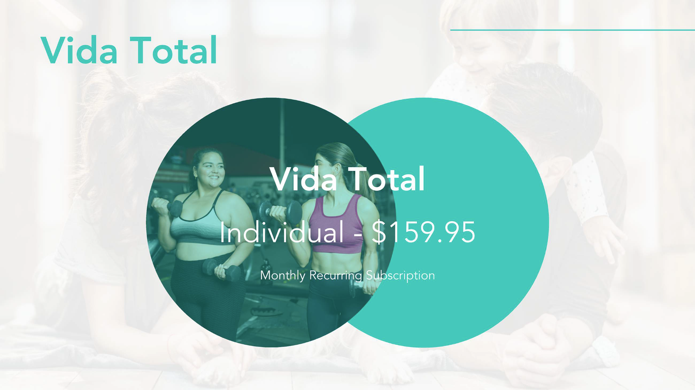
COMING SOON

Slide 13


Next-Gen Compensation
Our next generation hybrid model combines the best of modern affiliate marketing with the proven power of traditional direct sales residual income
Welcome to the future of opportunity with BeniVita™ -a groundbreaking compensation plan that invites you to step into the essential industries of healthcare and wellness.
This isn't just another compensation plan,
It's a chance to align with a mission that transforms lives while offering you the tools to build your own success.
It’s designed to reward you for what matters most: customer acquisition, teamwork, and creating long-term impact in your community.

Slide 14


CUSTOMER
AMBASSADOR:
EARN COMMISSIONS BY ACQUIRING ANY COMBINATION OF 25 PERSONAL CUSTOMERS IN THE FIRST 8 LEVELS.
PAY $150 TO JOIN AND AN ANNUAL RENEWAL FEE OF $49.99.
Simple monthly membership — 24/7 virtual urgent care, primary care, and therapy, all from your phone. No co-pays. No deductibles.
Care that fits your everyday life — hundreds of common medications included, plus savings on dental, vision, labs, and more.

Slide 15
Join the BeniVita™ Movement
What makes BeniVita™ different?
You’re not selling hype—you’re sharing a simple monthly membership people actually need—built around 4 essential benefits of everyday care:
24/7 virtual urgent care
Virtual primary care & chronic condition support
Mental health therapy
Hundreds of common medications included
With BeniVita™, you can earn $5 to $10 per personal customer, depending on the plan selected, plus commissions across 8 levels as your community grows.
Whether you’re a driven sales professional, a community leader, or an influencer with reach, this is an opportunity to build consistent, scalable income—by helping people access care that has become too expensive or out of reach.
Personal Commissions Paid Monthly
Lifetime Value, Lifetime Payouts
Industry-Leading Services
Simple & Seamless Affiliate System

Slide 16
The 4 Pillars of the BeniVita™ Ecosystem
New Benefits: A 40+ year established benefits company serving 25+ million customers and major corporations across the U.S. This provides the technology, compliance, and benefits network behind BeniVita.
Pillar 1: Infrastructure
Pillar 2 : Public Company
Panacea Life Sciences Holdings (PLSH): A publicly traded company providing transparency, oversight, and regulatory accountability. This adds credibility and financial transparency.
Pillar 3: Digital Membership Platform
A digital membership benefits platform providing:
• 24/7 virtual urgent care
• virtual primary care
• mental health support
• prescription savings
• discounts on dental, vision, labs, imaging, diabetic supplies, hearing, and pet medications
Affordable access to virtual care and everyday health benefits without the complexity of traditional insurance.
Pillar 4: Opportunity
A membership model where ambassadors help families access healthcare while earning recurring income.

Slide 17
How You Earn
Personal Commissions
Income Examples
Earn every time you refer a new customer. You’ll receive a monthly residual commission for each active subscription, for as long as they remain a customer. Personal Commissions are approximately 10% of revenue per month, for the life of the Customer – details are as follows:
These are sample case scenarios dependent upon a Customer mix of Service Plans. Individual results will vary, and there are no guarantees of your success; please refer to our Income Disclosure on Page 2 for more information about compensation.
Service
Plan
Monthly
Price
Monthly
Commission
Scenario
Personal Customers
Monthly Income*
Annual Income*
Essentials
$69.95
$5.00
Go-Getter
25
$125 - $250
$1,500 - $3,000
Plus
$79.95
$7.00
Community Leader
200
$1,000 - $2,000
$12,000 - $24,000
Family
$89.95
$10.00
Influencer
500
$2,500 - $5,000
$30,000 - $60,000
National Leader
2,500
$12,500 - $25,000
$150,000 - $300,000

Slide 18
Pacto Community Matrix
Every Customer is automatically placed into the Pacto Community Matrix, creating an opportunity for Ambassadors to earn residual income across multiple levels. At BeniVita™, we believe in building community, and this part of our compensation structure is available to anyone who chooses to become an Ambassador. There are no extra charges, hidden fees, or surprises—just a straightforward path to participate and grow.
Monthly Matrix Earnings
(Per Customer, by Level & Plan)
Level
Essentials
Plus
Family
Vida Total*
1
$1.00
$1.50
$2.00
$3.00
Depending upon each Service Plan, BeniVita™ has designed a dollar amount from each of these Service Plans for each of the levels in the Matrix. These amounts, by depth level are as follows:
2
$1.00
$1.50
$2.00
$3.00
3
$1.00
$1.50
$2.00
$3.00
4
$1.00
$1.50
$2.00
$3.00
5
$2.00
$2.50
$3.00
$4.00
6
$2.00
$2.50
$3.00
$4.00
7
$2.00
$2.50
$3.00
$4.00
8
$2.00
$2.50
$4.00
$5.00
*Vida Total package coming soon

Slide 19
Pacto Matrix & Personal Commission Income Combined Examples
The following are sample case scenarios dependent upon a Customer mix of Service Plans and feature the compensation based upon 4 different scenarios. These will vary greatly because Benivita pays both Personal Commission and Pacto Commissions, this double-dip component can affect your income greatly. Individual results will vary, and there are no guarantees of your success. Please refer to our income disclaimer on Page 2 for more information about compensation.
Income Scenario:
Fully Built Matrix
Personal Referred Sales at .25% of the Total Matrix
Positions
Customers
Essentials
Plus
Family
Vida Total*
Personal (.25%)
25
Level 1
3
$1.00
$1.50
$2.00
$3.00
Level 2
9
$1.00
$3.00
$6.00
$9.00
Level 3
27
$4.00
$7.50
$16.00
$30.00
Potential
Monthly Income
$10,000 PLUS
Level 4
81
$12.00
$24.00
$48.00
$87.00
Level 5
243
$72.00
$122.50
$219.00
$340.00
Level 6
729
$218.00
$365.00
$657.00
$1,020.00
Level 7
2187
$656.00
$1,092.50
$1,968.00
$3,064.00
Level 8*
6561
$1,968.00
$3,280.00
$7,872.00
$11,485.00
*25 customers required to get paid on Level 8
*Vida Total package coming soon

Slide 20

Questions?
Email us at:
info@benivita.com
For more information visit our website at:
https://benivita.com

